Slide 1
Enhanced Refresh-Flow for Power BI Dataset.
Project Link : EnhancedRefresh-FlowforPowerBIDataset_20220907140310.zip
Created By : NIHARIKA GAUR (BI DEVELOPER )

Slide 2
PROJECT FLOW
CREATE AZURE APP
CREATE AZURE RESOURCE GROUP AND ADD APPS IN THE GROUP
GRANT MEMBER ACCESS TO BOTH APP AND GROUP IN POWER BI WORKSPACE
CREATE POWER AUTOMATE FLOW

Slide 3
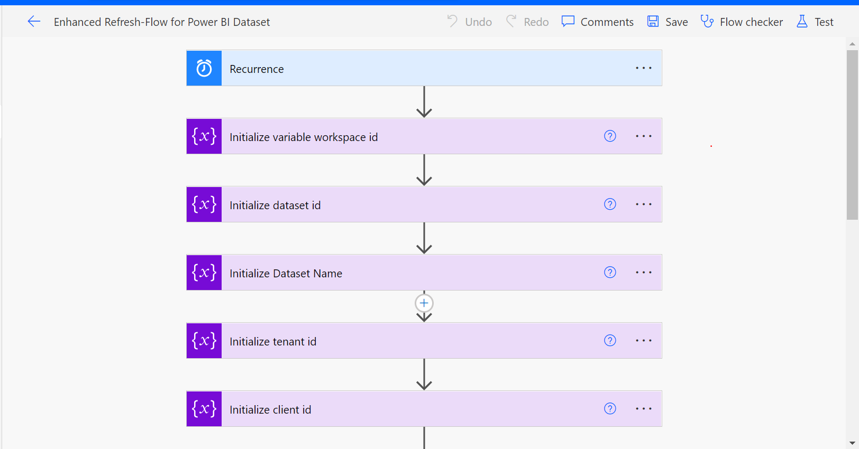

Slide 4
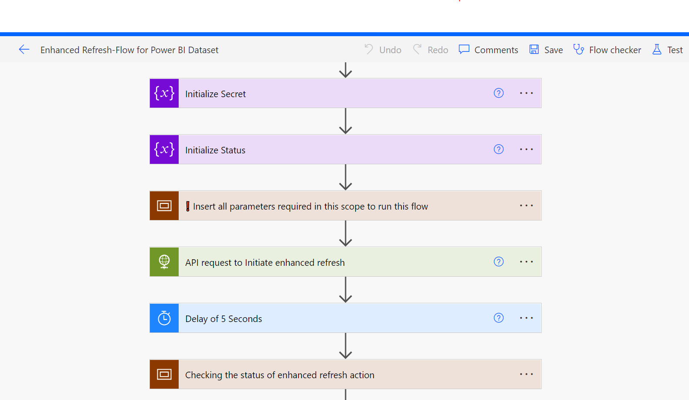

Slide 5
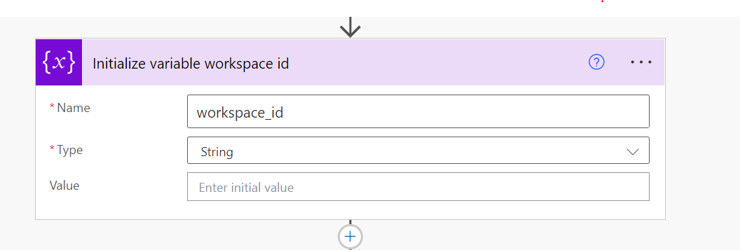

Slide 6


Slide 7
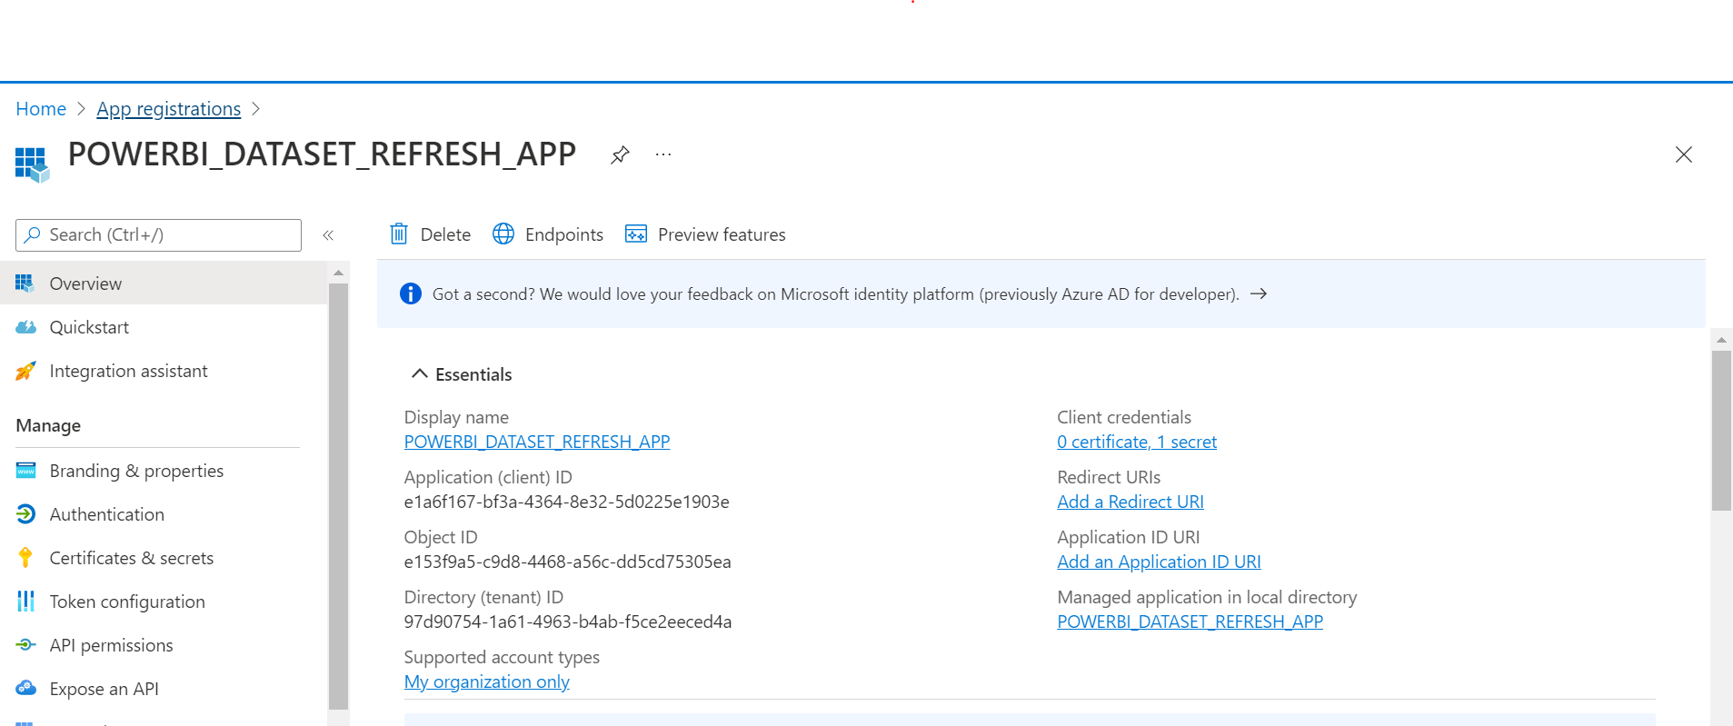

Slide 8
